Slide 1










Subtopic N1.4 – Order a List of Integers
LEARNING OUTCOME: To understand how to order integers.
Objectives:
Keywords:
Integer
Place Value
Ascending
Descending
To order integers using a number line.
To order integers without a number line.
To solve problems involving ordering integers.
Introduction – Read and annotate:
Ordering a list of integers builds on our understanding of place value and comparing numbers. By
arranging numbers from smallest to largest (or vice versa), we practise reading, writing, and
interpreting values accurately — whether they're written in digits or words.
Definition
Characteristics
A whole number.
Can be positive or negative.
No decimal or fractional part when simplified.
Integer
Examples
-42
1.1
-8.5
Non - Examples
11
-11
27.5
0.42
For the following questions, list the numbers in descending order.
Steps | 872, 802, 870, 780, 827 | 542, 412, 585, 591, 572 | 333, 395, 299, 313, 329
Look at the place value of the leftmost digit. Write down the number with the largest place value. | 872, 870, 827, 802, 780 | 591, 585, 572, 542, 412 | 395, 333, 329, 313, 299
If any have the same place value, look at the digit to the right and write down the number with the largest value. Repeat until all numbers have been ordered.
Ordering integers without a number line
Example 1 - I do…
Example 2 – We do…
Example 3 – You do…

Slide 2
For the following questions, list the numbers in ascending order.
Steps | 562, 56, 5620, 526, 5260 | 7312, 7321, 732, 73, 723 | 32, 372, 3372, 3732, 327
Look at the place value of the leftmost digit. Write down the number with the smallest place value. | 56, 526, 562, 5260, 5620 | 73, 723, 732, 7312, 7321 | 32, 327, 372, 3372, 3732
If any have the same place value, look at the digit to the right and write down the number with the smallest value. Repeat until all numbers have been ordered.
Example 11 – We do…
Example 12 – You do…
Example 10 - I do…
Independent Practice
1. For the following questions, list the numbers in ascending order.
a) 8, 5, 9, 10, 2 | b) 11, 20, 9, 15, 14, 3
c) 40, 60, 20, 30, 90, 10 | d) 83, 18, 45, 37, 90, 21
e) 140, 180, 210, 70, 300 | f) 605, 56, 566, 655, 506, 65, 555
g) 2000, 375, 7100, 2900, 999, 400 | h) 3000, 375, 3100, 3900, 399, 300
2, 5, 8, 9, 10 | 3, 9, 11, 14, 15, 20
10, 20, 30, 40, 60, 90 | 18, 21, 37, 45, 83, 90
70, 140, 180, 210, 300 | 56, 65, 506, 555, 566, 605, 655
375, 400, 999, 2000, 2900, 7100
300, 375, 399, 3000, 3100, 3900
2. Order the following temperatures from coldest to warmest: 8°C, 12°C, 9°C, 15°C, 11°C, 7°C, 2°C

Slide 3
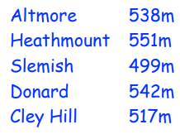
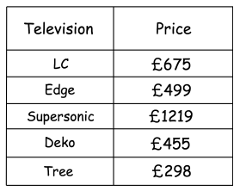
3. For the following questions, list the numbers in descending order.
a) 321, 301, 312, 213, 212 | b) 1031, 1021, 2021, 1030, 2020
c) 21031, 20121, 32021, 31030, 32020 | d) 21531, 21331, 21351, 231151, 23151
e) 20531, 20031, 25031, 23051, 21053 | f) 90531, 95031, 91530, 95130, 95101
321, 312, 301, 213, 212 | 2021, 2020, 1031, 1030, 1021
32021, 32020, 31030, 21031, 20121 | 231151, 23151, 21531, 21351, 21331
25031, 23051, 21053, 20531, 20031 | 91530, 95130, 95101, 95031, 90531
4. Shown below are the heights of five hills. List the hills in order of size, starting with the largest.
Heathmount
Donard
Altmore
Cley Hill
Slemish
5. The table shows the prices of five televisions Write down the televisions in order of price. Start with the cheapest television.
Tree
Deko
Edge
LC
Supersonic

Slide 4
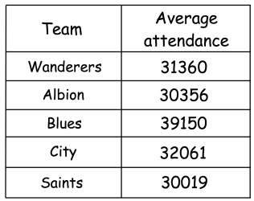
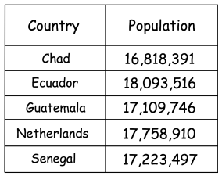
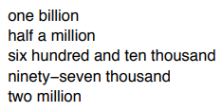
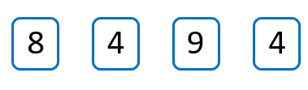
6. The table below shows the average attendance for five football teams last season. Write down the teams in order of average attendance. Start with the highest.
Blues
City
Wanderers
Albion
Saints
7. Here are the populations of five countries in 2022. Arrange the countries in order of population, starting with the smallest.
Chad
Guatemala
Senegal
Netherlands
Ecuador
8. Arrange these numbers in ascending order.
Ninety-seven thousand
Half a million
Six hundred and ten thousand
Two million
One billion
9. How many different four-digit numbers can you make using the cards below? Put your numbers in order, starting with the smallest.
12 combinations: 4489, 4498, 4849, 4894, 4948, 4984, 8449, 8494, 8944, 9448, 9484, 9844

Slide 5
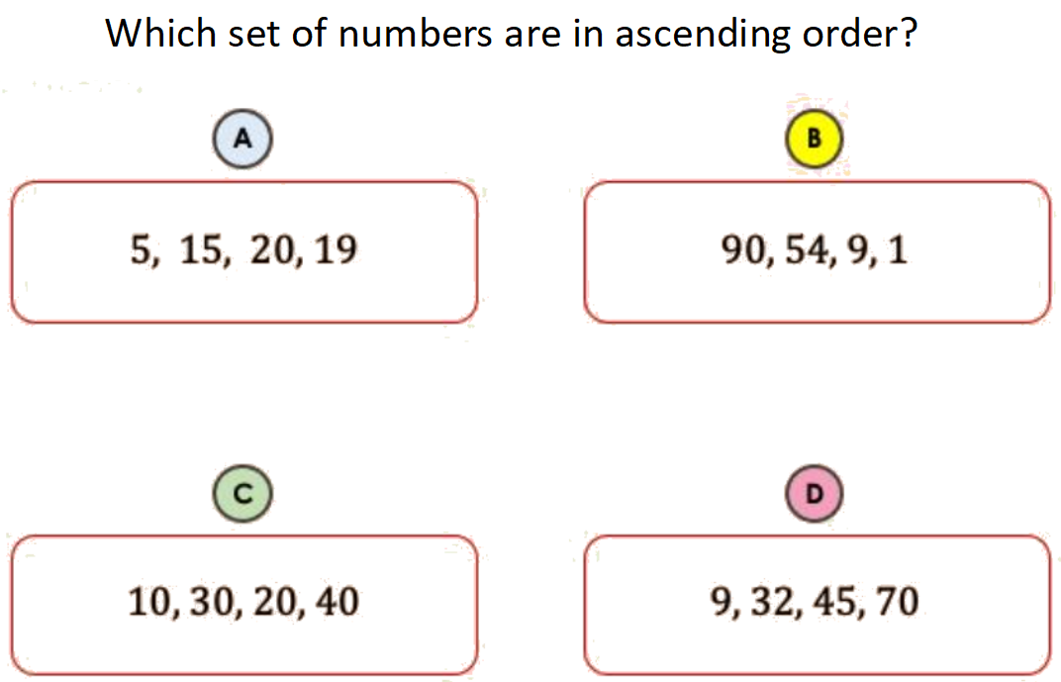

Skills Check

